Slide 1
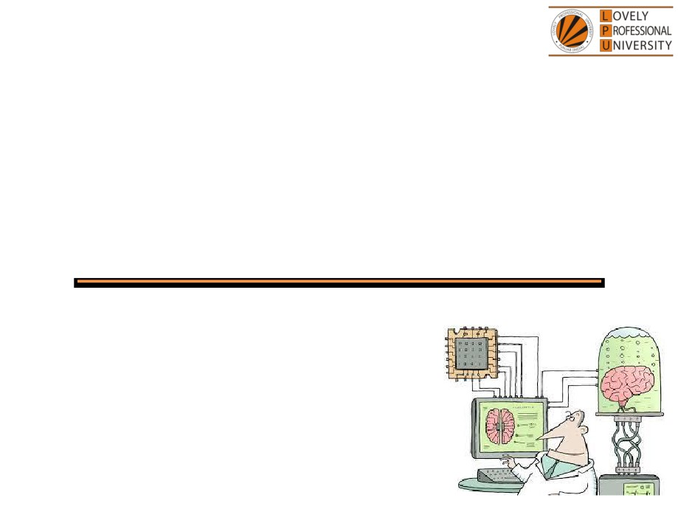
PEA516
Analytical Skills II
Lecture #0
Breaking the ice
Department of Analytical Skills

Slide 2

Course Details
LTP - 2 2 0 [Two lectures, Two Tutorial per week]
Text Book
Quantitative Aptitude by Dr.R S Aggarwal
Reference Book
ANALYTICAL REASONING by M.K. PANDEY
MAGICAL BOOK ON QUICKER MATHS by M TYRA

Slide 3
Course Assessment Model
Marks break up
• Attendance
15
• CA
30
• MTE (MCQ)
15
• ETE (MCQ)
40
• Total
100
• MTE & ETE to be done on OMR sheets
All tests will be based on MCQ.

Slide 4

Course Outcomes
CO1 :: employ the concepts learn to analyze and solve the problems related to work based on time and efficiency
CO2 :: use an appropriate approach to solve problems related to time, speed and distance
CO3 :: analyze the various logical reasoning techniques to solve problems related to series completion, coding decoding in minimum possible time
CO4 :: utilize the analytical skills to calculate the simple and compound interest
CO5 :: articulate an appropriate approach to solve the problems related to clock and calendar
CO6 :: analyze the logical reasoning aptitude problems related to puzzle test and non-verbal reasoning to solve accordingly

Slide 5
COURSE FOCUS IDENTIFICATION
Employability

Slide 6
Assessment and Evaluation Model
Assessment (Category) | Conducted Week
CA 1 (A0303) | Week 5 (Duration 50 Min Q 30)
MTE (11A) | After week 7 (Duration 60 Minutes Q 40)
CA 2 (A0303) | Week 10 (Duration 50 Min Q 30)
CA 3 (A0303) | Week 14 (Duration 50 Min Q 30)
ETE (11A) | After week 14 (Duration 120 Min Q 80)

Slide 7
Pedagogical Initiative
Lecture Number - Week – 5,12,13
Magic Maths - A workshop on quicker Maths
Finnovation - A workshop based on financial awareness
Combinatory -A workshop based on arrangement of numbers
(These workshops will enhance the problem-solving ability of the students as well as increase their calculation skills. Students also get familiarize with the advanced levelled questions of the topic thus increasing their competitive ability.)
Pedagogical Initiative

Slide 8
Pedagogical Initiative
Lecture Number - Week -6,7,10
Semantic Analogy-An event based on reasoning
Numero Uno - A competitive event based on SUDOKU
Time Crunch - An event based on rapid aptitude skills
(These events infuse the spirit of competition in the students. Students will enhance their competitive skills in solving the questions fast. It will increase their performance to secure the ranks in the events)

Slide 9
Pedagogical Initiative
Lecture Number - Week -7,14
Foundation Classes
(These online sessions help slow learner to learn at their own pace and provide them extra time to find solution with the help of the teacher.)
All tutorial classes
Company-specific Worksheets
(The company specific worksheets make the students familiarize with the company level questions.)

Slide 10
Innovative evaluation strategies
Evaluation | Conduct
CA 1 | External
MTE | External
CA 2 | External
CA 3 | External
ETE | External

Slide 11
Industry grade assessment
Mercer Mettl
AMCAT
(It is an employability test benchmarked with the industries. They have the questions well-aligned with company-specific question)

Slide 12
The course contents
Unit I
Time & work : work efficiency, computation of work done together, work on alternate days, negative and partial work, work and wages, chain rule
Pipe & cistern : single and multiple pipes working together, alternating pipes, volume of tank
Unit II
Time & distance : concept of time speed and distance, conversion of units, average speed, variable speeds
Problem on trains : relative speed concept, crossing a stationary and moving object
Boats & streams and races : concept of downstream and upstream, linear and circular track problems

Slide 13
The course contents
Unit III
Sequence and series completion : number series, alphabet series, alphanumeric series
Alphabet test and logical sequence of words : alphabetical and logical order of words, word formation by unscrambling letters, alpha-numeric sequence puzzle
Coding- decoding : letter coding, number and symbol coding, substitution coding, mixed letter coding, mixed number coding, language coding
Unit IV
Simple interest : principal, rate and time concept, rate computation, time computation, amount and interest computation
Compound interest : concept of compound interest, relation between compound and simple interest, depreciation problems
Insert the missing character : set of figures, set of arrangements, set of matrix

Slide 14
The course contents
Unit V
Calendar : calculating odd days, concept of calendar, finding the exact day and date
Clock : concept of clock, angle computation, loss or gain in time, faulty clock, mirror image of a clock
Data sufficiency : reasoning and quantitative data sufficiency problems
Unit VI
Coding inequalities : mathematical operations, rules of inequalities, coded relations
Puzzle test : seating/placing arrangements, comparison type questions, sequential order of things, family based problems
Non-verbal reasoning : series of figures, analogy of figures, classification of figures

Slide 15


Let us look around…
Why every organization takes Quantitative Aptitude Tests before hiring any future employee…

Slide 16
Right Decision Making
Mental Alertness
Ability to quickly interpret data
Establish logical relationship
Arrive at the correct conclusions
Make the right judgment

Slide 17
Organizations recruit people who have
Quick Mental Abilities.
PEA502 Analytical Skills-II :: Vishal Ahuja

Slide 18
How you will make your mental ability Quick…!!!
Quick = Tricks
PEA502 Analytical Skills-II :: Vishal Ahuja

Slide 19
A monkey jumps 5 yards every second on a 60 yards vertical pole and then falls down 2 yards over the next second. How many seconds will it take to climb the pole?

Slide 20

1 minute…???
2 minutes…???
5 minutes…???
10 minutes…???
Well…!!! It will not take more than 30 SECONDS

Slide 21
And What about this….?
On which day of the week INDIAN constitution formed?
26 Jan 1950!!

Slide 22
5 minute…???
10 minutes…???
15 minutes…???
20 minutes…???
Again…!!! It will not take more than 30 SECONDS.

Slide 23

What is the angle between the hands at 3:15 in an analog clock
What do we need to know?

Slide 24
What do we need to know?
This course PEA516 : Analytical Skills-II
Ability to efficiently solve the company specific Quantitative
Aptitude Tests.
Ability to prioritize and manage Time.
Ability to efficiently analyze data.

Slide 25


Next Class: Time and Work

